Slide 1
Capstone project
By Laurentia Rosca

Slide 2

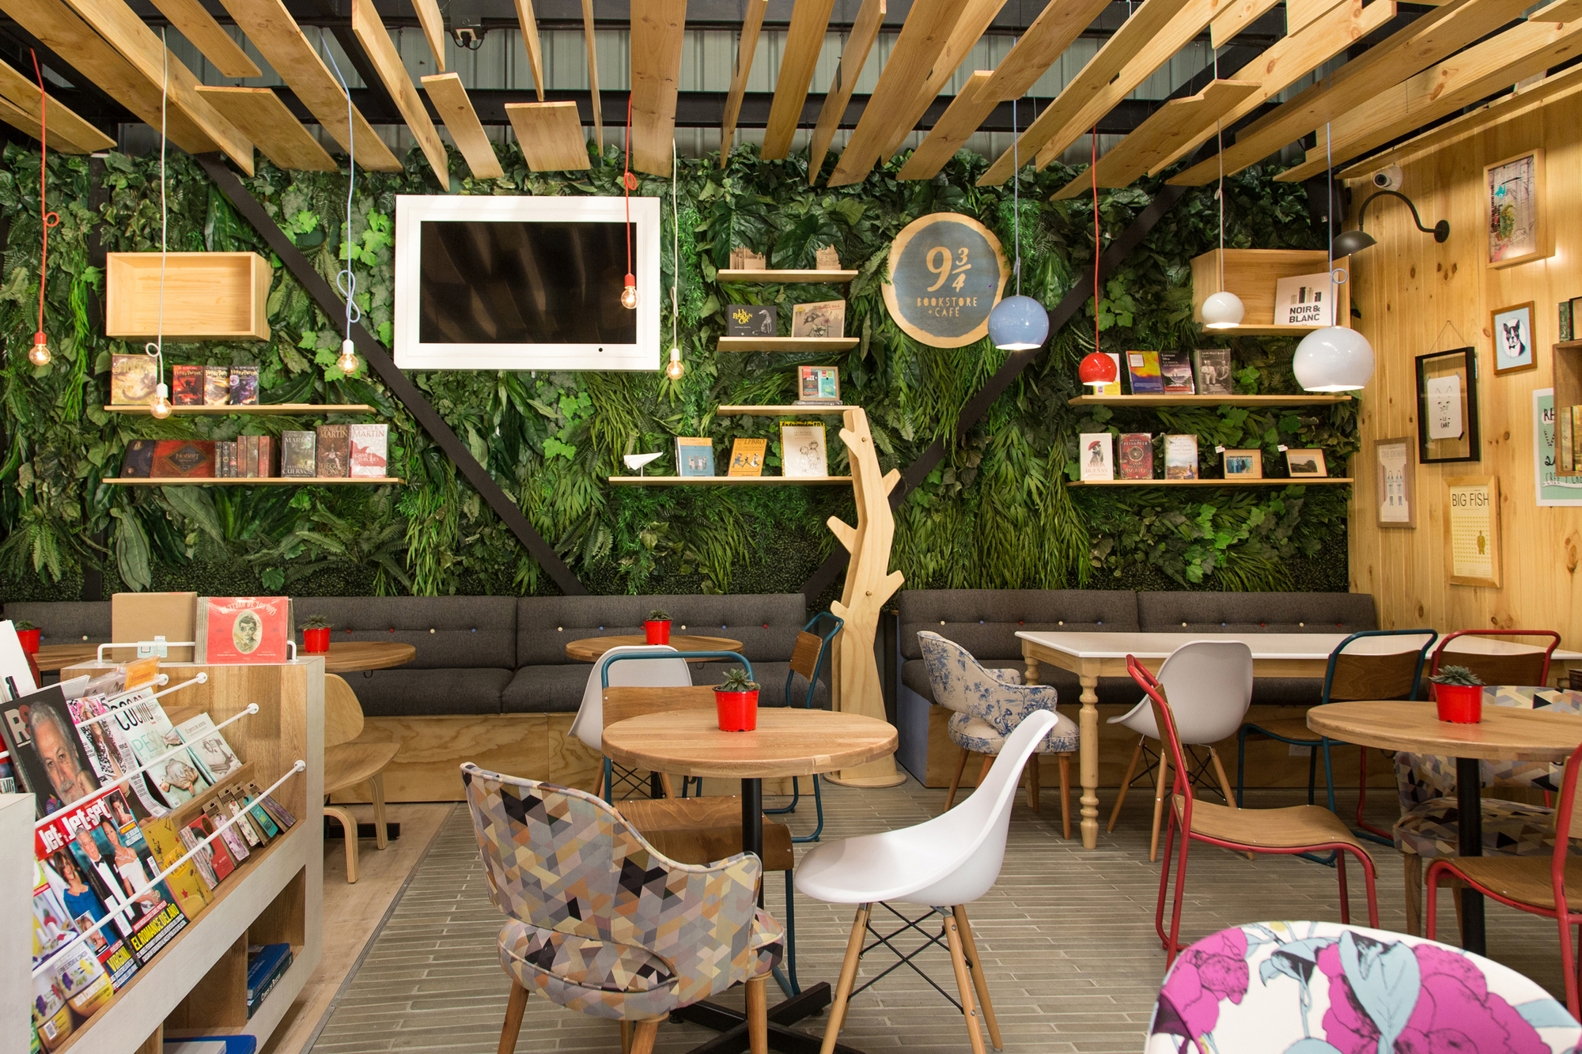
Problem:
Where to open a Bookstore&Café place in Budapest

Slide 3
The main criteria for the selection of the location:
1. Area close to university/college
2. Area with less competitors (bookstores and cafes)
3. Close to central area

Slide 4
Data:
used Foursquare APIs to gather information about the universities, coffee shops and bookstores located in the central area of Budapest
The information contained location data (address, latitude, longitude, postal code, etc.), as well as other data (venue id, category, contact, rating, tips, as well as photos, like, description, menu, etc)

Slide 5
methodology:
Step 1
Create a search query to find universities, coffee shops and bookstores in the central area of Budapest.
visualize on a map all the venues found by using folium library

Slide 6
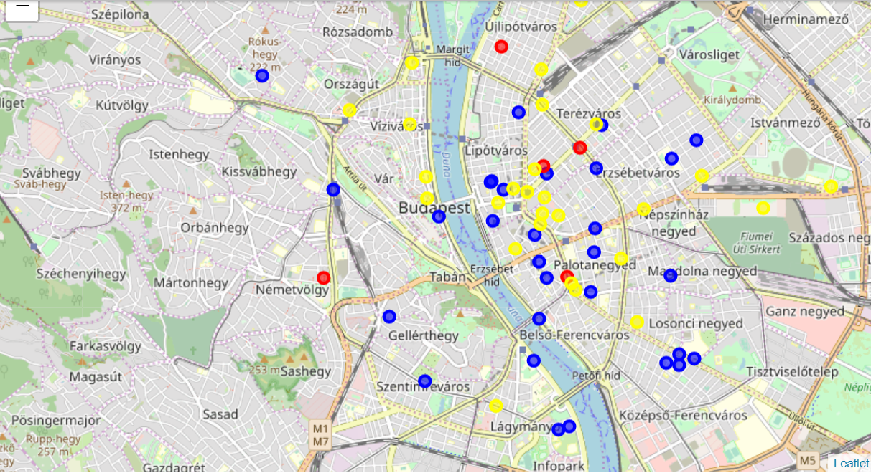
Blue:universities
Yellow:coffee shops
Red:bookstores

Slide 7
Step 2
Choose candidate universities: Central European University, Eötvös Loránd University and Corvinus University.
explore the area within 500 m from the candidate to find existing coffee shops and bookstores.
use the .value_counts() function to count the venues in every area

Slide 8
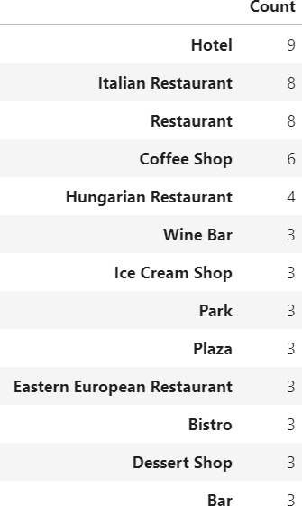
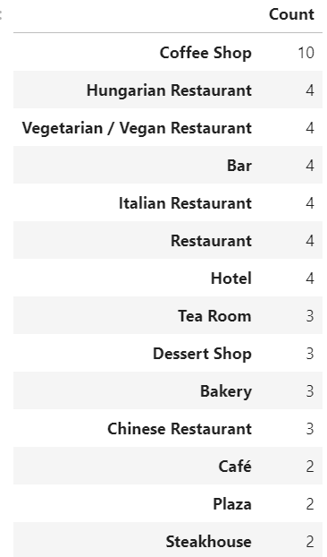
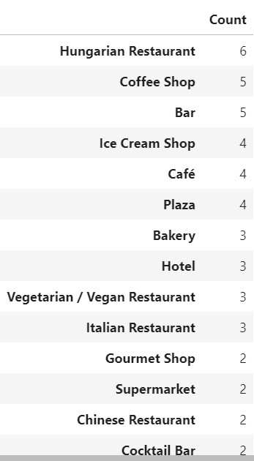
Central European University
Eötvös Loránd University
Corvinus University

Slide 9
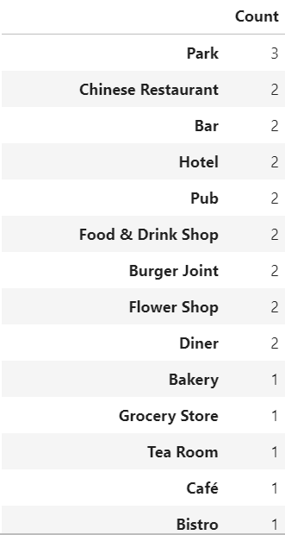
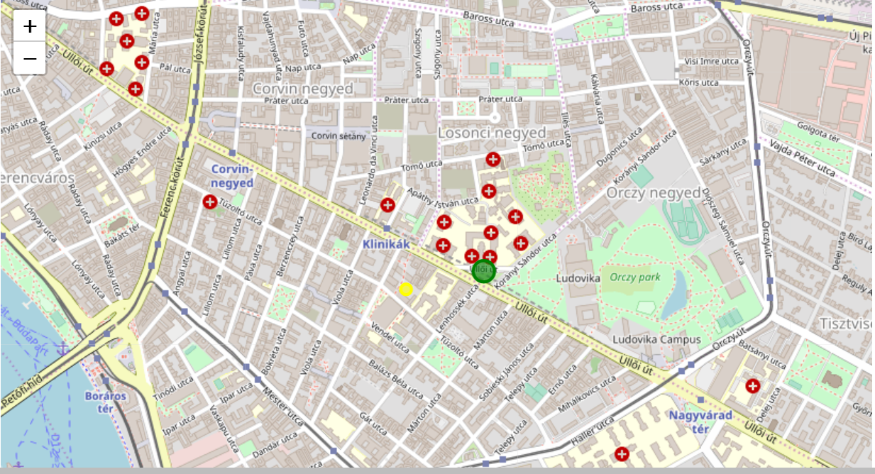
Step 3
Considering a last candidate: Semmelweis University using same approach

Slide 10
conclusion:
The analysis has rendered 2 possible locations:
Area around Corvinus University Area around Semmelweis University
central location
rather few competitors
nice view over the Danube
tourist hub
hub for medical students
just one competitor
lower rental fees
high availability
Final decision is with the stakeholder

Slide 11
Thank you ☺

